Slide 1

GPIO Interrupt pin circuit
Pullup resistor
MCU

Slide 2
GPIO Interrupt pin setting
GPIO pin mode : Input
  GPIO_SetMode(PB, BIT12, GPIO_MODE_INPUT);
GPIO pin chip internal Pull-up
  GPIO_ENABLE_PULL_UP(PB, BIT12);
GPIO interrupt trigger type : RISING/FALLING/BOTH_EDGE/HIGH/LOW
  GPIO_EnableInt(PB, BIT12, GPIO_INT_FALLING);
GPIO Interrupts : two groups = ABC or DEF
  NVIC_EnableIRQ(GPABC_IRQn); // ABC group share 1 interrupt to CPU
  NVIC_EnableIRQ(GPDEF_IRQn); // DEF group share 1 interrupt to CPU
GPIO pin debouncing
  Debounce Clock Source = LIRC (10KHz) or HCLK
  GPIO_SET_DEBOUNCE_TIME(GPIO_DBCLKSRC_LIRC, GPIO_DBCLKSEL_64);
  GPIO_ENABLE_DEBOUNCE(PB, BIT12);

Slide 3
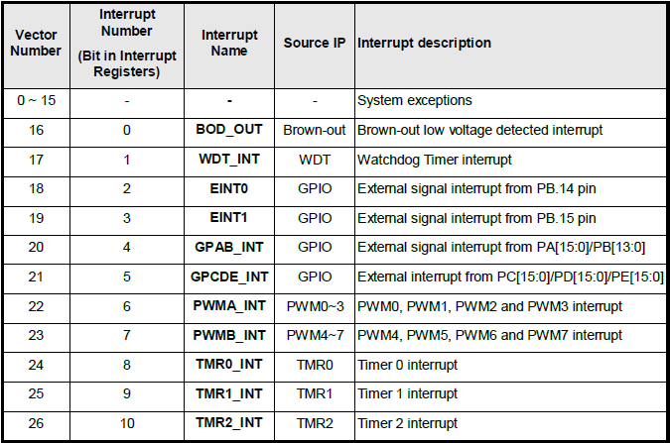
External Interrupt Pins (INT0 & INT1)
Two Pins dedicated for External Interrupt (higher interrupt priority then GPIO interrupt)

Slide 4
GPIO_EXTINT
void Init_EXTINT(void)
{
// Configure EINT0 pin and enable interrupt by falling edge trigger
GPIO_SetMode(PB, BIT14, GPIO_MODE_INPUT);
GPIO_EnableEINT0(PB, 14, GPIO_INT_FALLING);
NVIC_EnableIRQ(EINT0_IRQn);
// Configure EINT1 pin and enable interrupt by rising and falling edge trigger
GPIO_SetMode(PB, BIT15, GPIO_MODE_INPUT);
GPIO_EnableEINT1(PB, 15, GPIO_INT_RISING); // RISING, FALLING, BOTH_EDGE, HIGH, LOW
NVIC_EnableIRQ(EINT1_IRQn);
// Enable interrupt de-bounce function and select de-bounce sampling cycle time
GPIO_SET_DEBOUNCE_TIME(GPIO_DBCLKSRC_LIRC, GPIO_DBCLKSEL_64);
GPIO_ENABLE_DEBOUNCE(PB, BIT14);
GPIO_ENABLE_DEBOUNCE(PB, BIT15);
}

Slide 5
GPIO_EXTINT
int32_t main()
{
SYS_Init();
Init_EXTINT();
while(1);
}
Note: Open Debug Session to run in Keil MDK to see printf message !

Slide 6
GPIO_EXTINT
void EINT0_IRQHandler(void)
{
GPIO_CLR_INT_FLAG(PB, BIT14); // Clear GPIO interrupt flag
printf("PB14 EINT0 occurred.\n");
}
void EINT1_IRQHandler(void)
{
GPIO_CLR_INT_FLAG(PB, BIT15); // Clear GPIO interrupt flag
printf("PB15 EINT1 occurred.\n");
}

Slide 7
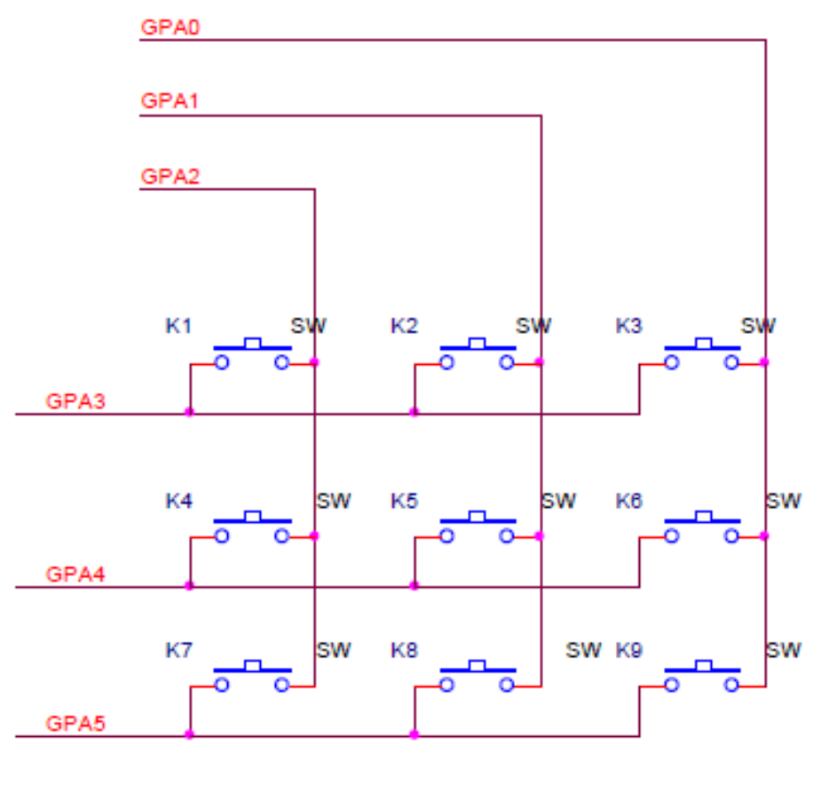
3x3 Keypad schematic

Slide 8
Initialize GPIO interrupt pins
// KEY1 to PB12, KEY2 to PB13, KEY3 to PB14
void Init_KEY(void)
{
GPIO_SetMode(PB, (BIT12 | BIT13 | BIT14), GPIO_MODE_INPUT);
GPIO_ENABLE_PULL_UP(PB, (BIT12 | BIT13 | BIT14));
GPIO_EnableInt(PB, 12, GPIO_INT_FALLING);
GPIO_EnableInt(PB, 13, GPIO_INT_FALLING);
GPIO_EnableInt(PB, 14, GPIO_INT_FALLING);
NVIC_EnableIRQ(GPAB_IRQn);
GPIO_SET_DEBOUNCE_TIME(GPIO_DBCLKSRC_LIRC, GPIO_DBCLKSEL_64);
GPIO_ENABLE_DEBOUNCE(PB, (BIT12 | BIT13 | BIT14));
}

Slide 9
GPIO_IRQ
int32_t main()
{
SYS_Init();
Init_KEY();
printf("Testing KEY1/2/3 IRQ generation:\n");
while(1) {
if (KEY1_Flag) {
printf("KEY1/PB12 Interrupt!\n");
KEY1_Flag=0; }
if (KEY2_Flag) {
printf("KEY2/PB13 Interrupt!\n"); KEY2_Flag=0; }
if (KEY3_Flag) {
printf("KEY3/PB14 Interrupt!\n");
KEY3_Flag=0; }
}
}

Slide 10
GPAB_IRQHandler
void GPAB_IRQHandler(void)
{
if (PB->ISRC & BIT12) { // check if PB12 interrupt occurred
PB->ISRC |= BIT12; // clear PB12 interrupt status
KEY1_Flag=1; // set a flag for PB12(KEY1)
} else if (PB->ISRC & BIT13) { // check if Pb13 interrupt occurred
PB->ISRC |= BIT13; // clear PB13 interrupt status
KEY2_Flag=1; // set a flag for PB13(KEY2)
} else if (PB->ISRC & BIT14) { // check if PB14 interrupt occurred
PB->ISRC |= BIT14; // clear PB14 interrupt status
KEY3_Flag=1; // set a flag for PB14(KEY3)
} else { // else it is unexpected interrupts
PB->ISRC = PB->ISRC; // clear all GPB pins
}
}
}

Slide 11
Timer Features
Four 24-bit up-counting timer
A prescaler (divider) for each Timer
Selectable 5 clock source
  Four modes : one shot, periodic, toggle, continuous
Timeout Period calculation
  Time out period =
  (Period of timer clock source)
  *(8-bit Prescale + 1)
  * (24-bit TCMP)

Slide 12
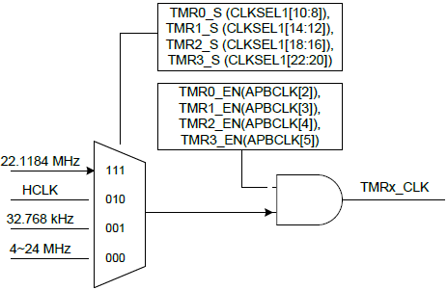
Timer Clock Source
NUC140

Slide 13
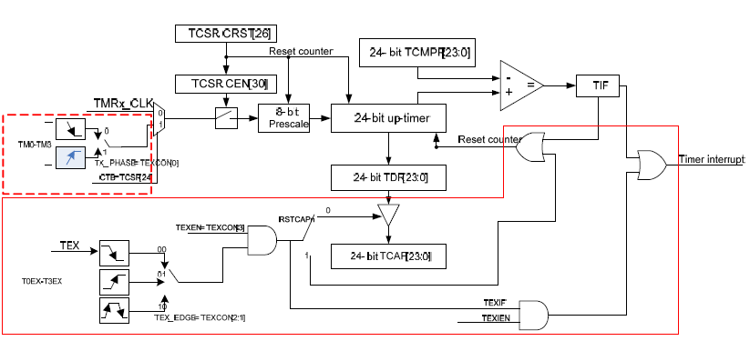
NUC140 Timer Block Diagram

Slide 14
Timer operation modes
Example: TCMPR = 100
One-Shot mode
Periodic mode / Toggle mode
Continuous Counting mode
Interrupt
0
One shot
100
Reset counter
Periodic
0
100
Overflow
0
100
Continuous
101
2²⁴-1

Slide 15
TMR_LED
volatile uint8_t ledState =0;
void TMR1_IRQHandler(void)
{
ledState = ~ ledState; // changing ON/OFF state
if(ledState) PC12=0;
else PC12=1;
TIMER_ClearIntFlag(TIMER1); // Clear Timer1 time-out interrupt flag
}

Slide 16
TMR_LED
int main(void)
{
SYS_Init(); // Intialize System/Peripheral clocks & multi-function I/Os
GPIO_SetMode(PC, BIT12, GPIO_MODE_OUTPUT); // set LED GPIO pin
TIMER_Open(TIMER1, TIMER_PERIODIC_MODE, 1); //Initialize TIMER1
TIMER_EnableInt(TIMER1);
NVIC_EnableIRQ(TMR1_IRQn);
TIMER_Start(TIMER1);
while(1);
}

Slide 17
TMR_Counters
volatile uint32_t counter[4] ={0,0,0,0};
void TMR0_IRQHandler(void)
{
counter[0]++;
counter[1]++;
counter[2]++;
counter[3]++;
if (counter[0]>=10) counter[0]=0;
if (counter[1]>=20) counter[1]=0;
if (counter[2]>=30) counter[2]=0;
if (counter[3]>=40) counter[3]=0;
printf("%d %d %d %d\n", counter[0], counter[1], counter[2], counter[3]);
TIMER_ClearIntFlag(TIMER0);
}

Slide 18
TMR_Counters
void Init_Timer0(void)
{
TIMER_Open(TIMER0, TMR0_OPERATING_MODE, TMR0_OPERATING_FREQ);
TIMER_EnableInt(TIMER0);
NVIC_EnableIRQ(TMR0_IRQn);
TIMER_Start(TIMER0);
}
int main(void)
{
SYS_Init();
Init_Timer0();
while(1);
}

Slide 19
TMR_Modes
volatile uint8_t ledState[4] =0;
void TMR0_IRQHandler(void)
{
ledState[0] = ~ ledState[0]; // changing ON/OFF state
if(ledState[0]) PC12=0;
else PC12=1;
TIMER_ClearIntFlag(TIMER0); // Clear Timer0 time-out interrupt flag
}
void TMR1_IRQHandler(void)
{
ledState[1] = ~ ledState[1]; // changing ON/OFF state
if(ledState[1]) PC13=0;
else PC13=1;
TIMER_ClearIntFlag(TIMER1); // Clear Timer1 time-out interrupt flag
}
each Timer set to different mode
and control 1 red LED

Slide 20
TMR_Modes
void TMR2_IRQHandler(void)
{
ledState[2] = ~ ledState[2]; // changing ON/OFF state
if(ledState[2]) PC14=0;
else PC14=1;
TIMER_ClearIntFlag(TIMER2); // Clear Timer2 time-out interrupt flag
}
void TMR3_IRQHandler(void)
{
ledState[3] = ~ ledState[3]; // changing ON/OFF state
if(ledState[3]) PC15=0;
else PC15=1;
T IMER_ClearIntFlag(TIMER3); // Clear Timer3 time-out interrupt flag
}

Slide 21
TMR_Modes
int main(void)
{
SYS_Init(); // Intialize System/Peripheral clocks & multi-function I/Os
GPIO_SetMode(PC, (BIT12 | BIT13 | BIT14 | BIT15), GPIO_MODE_OUTPUT); // set LED GPIO pin
TIMER_Open(TIMER0, TIMER_ONESHOT_MODE, 1); //Initialize TIMER0
TIMER_EnableInt(TIMER0);
NVIC_EnableIRQ(TMR0_IRQn);
TIMER_Open(TIMER1, TIMER_PERIODIC_MODE, 1); //Initialize TIMER1
TIMER_EnableInt(TIMER1);
NVIC_EnableIRQ(TMR1_IRQn);
TIMER_Open(TIMER2, TIMER_TOGGLE_MODE, 1); //Initialize TIMER2
TIMER_EnableInt(TIMER2);
NVIC_EnableIRQ(TMR2_IRQn);
TIMER_Open(TIMER3, TIMER_CONTINUOUS_MODE, 1); //Initialize TIMER3
TIMER_EnableInt(TIMER3);
NVIC_EnableIRQ(TMR3_IRQn);
open 4 Timers at different mode with same frequency

Slide 22
TMR_Modes
TIMER_Start(TIMER0);
TIMER_Start(TIMER1);
TIMER_Start(TIMER2);
TIMER_Start(TIMER3);
while(1);
}

Slide 23
Timer Capture
Falling Edge
Rising Edge
TC0/1/2/3 pin
Timer Capture at
Rising Edge
Timer counting
by Timer Clock

Slide 24
Timer_Capture_PWM
uint8_t Timer_flag =0;
uint32_t Timer_count =0;
void TMR0_IRQHandler(void)
{
TIMER0->TEXCON &= ~(TIMER_TEXCON_RSTCAPSEL_Msk); // set RSTCAPSEL to 0 to read counter
Timer_count = TIMER_GetCaptureData(TIMER0);
TIMER0->TEXCON |= (TIMER_TEXCON_RSTCAPSEL_Msk); // set RSTCAPSEL to 1 to reset counter
Timer_flag =1;
TIMER_ClearCaptureIntFlag(TIMER0);
}
PWM0 ch0 connected TC0

Slide 25
Init_TimerCapture()
void Init_TimerCapture(void)
{
TIMER_Open(TIMER0, TMR0_OPERATING_MODE, TMR0_OPERATING_FREQ);
TIMER_SET_PRESCALE_VALUE(TIMER0, 11);
// Set compare value as large as possible, so don't need to worry about counter overrun too frequently.
TIMER_SET_CMP_VALUE(TIMER0, 0xFFFFFF);
TIMER_EnableCapture(TIMER0, TMR0_CAPTURE_MODE, TMR0_CAPTURE_EDGE);
TIMER_EnableCaptureInt(TIMER0); // Enable timer interrupt
NVIC_EnableIRQ(TMR0_IRQn);
TIMER_Start(TIMER0);
}

Slide 26
Init_PWM() & Main
void Init_PWM(void)
{
PWM_ConfigOutputChannel(PWM0, PWM_CH0, 50, 10);
PWM_EnableOutput(PWM0, PWM_CH_0_MASK);
PWM_Start(PWM0, PWM_CH_0_MASK);
}
int main(void)
{
SYS_Init();
printf("Timer0 Capturing PWM0 ch0\n");
Init_PWM();
Init_TimerCapture();
while(1) {
if (Timer_flag==1) {
TIMER_Stop(TIMER0);
printf("Timer Capture Count = %d\n", Timer_count);
Timer_flag=0;
TIMER_Start(TIMER0);
}
}
}

Slide 27
Timer_EventCount
Uint32_t Timer_count =0;
void TMR0_IRQHandler(void)
{
Timer_count++;
TIMER_ClearIntFlag(TIMER0);
TIMER_Start(TIMER0);
}
void Init_Timer(void)
{
TIMER_Open(TIMER0, TMR0_OPERATING_MODE, TMR0_OPERATING_FREQ);
TIMER_SET_PRESCALE_VALUE(TIMER0, 0);
TIMER_SET_CMP_VALUE(TIMER0, 1000); // set compared value to 1000
TIMER_EnableEventCounter(TIMER0, TMR0_COUNTING_EDGE);
TIMER_EnableInt(TIMER0);
NVIC_EnableIRQ(TMR0_IRQn);
TIMER_Start(TIMER0);
}
PB11 connected TM0

Slide 28
Timer_EventCount
int main(void)
{
uint16_t i;
SYS_Init();
Init_Timer();
GPIO_SetMode(PB, BIT11, GPIO_MODE_OUTPUT);
PB11=0;
for(i = 0; i <5000; i++) {
PB11=0;
CLK_SysTickDelay(10);
PB11=1;
CLK_SysTickDelay(10);
}
PB11=0;
printf("Timer0 EVentCount = 1000 x %d\n", Timer_count);
while(1);
}

Slide 29
WatchDog Timer
18-bit up counter
8 selections of time out period
Support function:
  WDT interrupt
  WDT reset
  WDT wakeup

Slide 30
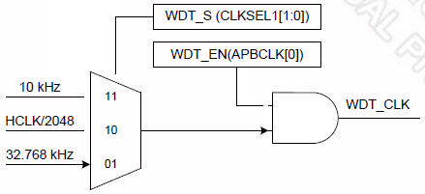
WDT Clock Source
LIRC
LXT

Slide 31
MCU_init.h
//Define Clock source
#define MCU_CLOCK_SOURCE
#define MCU_CLOCK_SOURCE_HXT // HXT, LXT, HIRC, LIRC
#define MCU_CLOCK_SOURCE_LXT
#define MCU_CLOCK_FREQUENCY 32000000 //Hz
//Define MCU Interfaces
#define MCU_INTERFACE_WDT

Slide 32
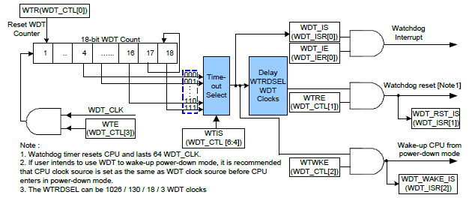
WDT block diagram

Slide 33
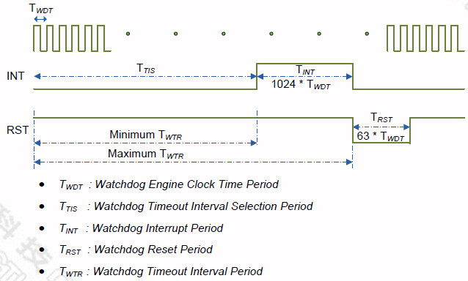
WDT Interrupt & Reset timing diagram

Slide 34
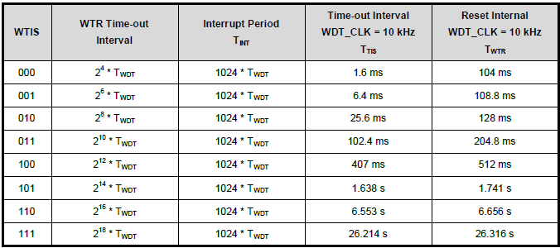
WDT Time-out
Time-out
Interrupt
10KHz = 0.1ms
2^n x0.1ms
1024x0.1ms
=102.4ms

Slide 35
WDT Time-out
12MHz
32KHz
WTIS | Interrupt Timeout | Watchdog Reset Timeout | WTR Timeout Interval for Reset (WDT_CLK=12MHz) | WTR Timeout Interval for Reset (WDT_CLK=32KHz)
000 | 2⁴ WDT_CLK (16 WDT_CLK) | (2⁴ + 1024) WDT_CLK (1040 WDT_CLK) | 86.67us | 32.5 ms
001 | 2⁶ WDT_CLK | (2⁶ + 1024) WDT_CLK | 90.67 us | 34 ms
010 | 2⁸ WDT_CLK | (2⁸ + 1024) WDT_CLK | 106.67 us | 40 ms
011 | 2¹⁰ WDT_CLK | (2¹⁰ + 1024) WDT_CLK | 170.67 us | 64 ms
100 | 2¹² WDT_CLK | (2¹² + 1024) WDT_CLK | 426.67 us | 160 ms
101 | 2¹⁴ WDT_CLK | (2¹⁴ + 1024) WDT_CLK | 1.45 ms | 544 ms
110 | 2¹⁶ WDT_CLK | (2¹⁶ + 1024) WDT_CLK | 5.55 ms | 2080 ms
111 | 2¹⁸ WDT_CLK | (2¹⁸ + 1024) WDT_CLK | 21.93 ms | 8224 ms

Slide 36
WDT_Interrupt
volatile uint8_t ledState =0;
void WDT_IRQHandler(void)
{
ledState = ~ledState;
WDT_CLEAR_TIMEOUT_INT_FLAG(); // Clear WDT interrupt flag
}
void Init_WDT(void)
{
// WDT timeout every 2^14 WDT clock, disable system reset, disable wake up system
SYS_UnlockReg();
WDT_Open(WDT_TIMEOUT_2POW14, 0, FALSE, FALSE);
WDT_EnableInt(); // Enable WDT timeout interrupt
NVIC_EnableIRQ(WDT_IRQn); // Enable Cortex-M0 NVIC WDT interrupt vector
SYS_LockReg();
}

Slide 37
WDT_Interrupt
void Init_GPIO(void)
{
GPIO_SetMode(PC, BIT12, GPIO_PMD_OUTPUT);
PC12=1;
}
int32_t main (void)
{
SYS_Init();
Init_WDT();
Init_GPIO();
while(1) {
if(ledState==0) PC12=0;
else PC12=1;
}
}

Slide 38
WDT_Interrupt
//
// smpl_WDT_Interrupt : interrupt every 1024 WDT time
//
#include <stdio.h>
#include "Nano1x2Series.h"
void WDT_IRQHandler(void)
{
printf("WDT Interrupt !!!\n");
WDT_CLEAR_TIMEOUT_INT_FLAG(); // Clear WDT interrupt flag
}

Slide 39
Real Time Clock
Real Time Clock (RTC) controller provides user the real time and calendar message. The clock source of RTC is from an external 32.768 kHz low speed crystal connected at pins X32I and X32O (Refer to to pin Description) or from an external 32.768 kHz low speed oscillator output fed at pin X32I.

Slide 40
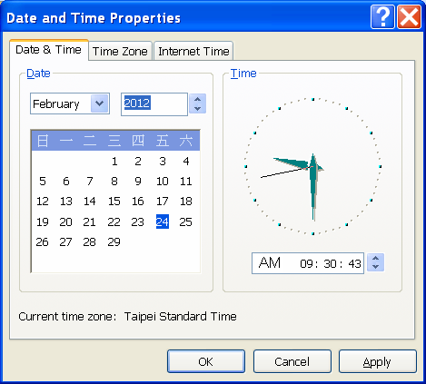

RTC Features
RTC counter
  Time counter
  Calendar counter
  Day of week
  Leap year
  BCD format
    TLR=0x00093043
    CLR=0x00120229
A set of Alarm
Alarm and time tick interrupt
Wakeup function
32KHz compensation

Slide 41
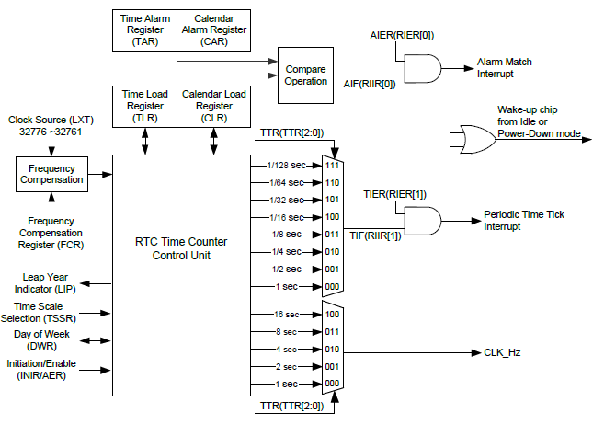
RTC block diagram

Slide 42
RTC IRQHandler & TickHandler
void RTC_IRQHandler(void)
{
if ( (RTC->RIER & RTC_RIER_TIER_Msk) && (RTC->RIIR & RTC_RIIR_TIF_Msk) ) { /* tick interrupt occurred */
RTC->RIIR = 0x2;
RTC_TickHandler();
}
}
void RTC_TickHandler(void)
{
S_RTC_TIME_DATA_T sCurTime;
RTC_GetDateAndTime(&sCurTime); // Get the current time to printf
printf(" Current Time:%d/%02d/%02d %02d:%02d:%02d\n",sCurTime.u32Year,sCurTime.u32Month,sCurTime.u32Day,sCurTime.u32Hour,sCurTime.u32Minute,sCurTime.u32Second);
g_u32TICK++;
}

Slide 43
RTC main.c
int32_t main(void)
{
S_RTC_TIME_DATA_T sInitTime;
SYS_Init();
// Time Setting
sInitTime.u32Year = 2015;
sInitTime.u32Month = 04;
sInitTime.u32Day = 26;
sInitTime.u32Hour = 12;
sInitTime.u32Minute = 30;
sInitTime.u32Second = 0;
sInitTime.u32DayOfWeek = RTC_SUNDAY;
sInitTime.u32TimeScale = RTC_CLOCK_24;
RTC_Open(&sInitTime);

Slide 44
RTC main.c
printf("RTC Time Test Begin...\n");
printf("(Exit after 5 seconds)\n\n");
// Set Tick Period
RTC_SetTickPeriod(RTC_TICK_1_SEC);
// Enable RTC Tick Interrupt
RTC_EnableInt(RTC_RIER_TIER_Msk);
NVIC_EnableIRQ(RTC_IRQn);
g_u32TICK = 0;
while(g_u32TICK < 5);
printf("\nRTC Time Test End...\n");
// Disable RTC Tick Interrupt
RTC_DisableInt(RTC_RIER_TIER_Msk);
NVIC_DisableIRQ(RTC_IRQn);
}

Slide 45
RTC IRQHandler & AlarmHandler
void RTC_IRQHandler(void)
{
if ( (RTC->RIER & RTC_RIER_AIER_Msk) && (RTC->RIIR & RTC_RIIR_AIF_Msk) ) { /* alarm interrupt occurred */
RTC->RIIR = 0x1;
RTC_AlarmHandler();
}
}
volatile int32_t g_bAlarm = FALSE;
void RTC_AlarmHandler(void)
{
printf(" Alarm!!!\n");
g_bAlarm = TRUE;
}

Slide 46
RTC main.c
int32_t main(void)
{
S_RTC_TIME_DATA_T sInitTime;
S_RTC_TIME_DATA_T sCurTime;
SYS_Init();
// Time Setting
sInitTime.u32Year = 2015;
sInitTime.u32Month = 4;
sInitTime.u32Day = 26;
sInitTime.u32Hour = 12;
sInitTime.u32Minute = 30;
sInitTime.u32Second = 0;
sInitTime.u32DayOfWeek = RTC_SUNDAY;
sInitTime.u32TimeScale = RTC_CLOCK_24;
RTC_Open(&sInitTime);

Slide 47
RTC main.c
printf("RTC Alarm Test Begin...\n");
printf("(Alarm after 5 seconds)\n\n");
g_bAlarm = FALSE;
RTC_GetDateAndTime(&sCurTime); // Get the current time
printf(" Current Time:%d/%02d/%02d %02d:%02d:%02d\n",sCurTime.u32Year,sCurTime.u32Month,
sCurTime.u32Day,sCurTime.u32Hour,sCurTime.u32Minute,sCurTime.u32Second);
// The alarm time setting
sCurTime.u32Second = sCurTime.u32Second + 5;
RTC_SetAlarmDateAndTime(&sCurTime); // Set the alarm time
RTC_EnableInt(RTC_RIER_AIER_Msk); // Enable RTC Alarm Interrupt
NVIC_EnableIRQ(RTC_IRQn);
while(!g_bAlarm);
printf(" Current Time:%d/%02d/%02d %02d:%02d:%02d\n",sCurTime.u32Year,sCurTime.u32Month,
sCurTime.u32Day,sCurTime.u32Hour,sCurTime.u32Minute,sCurTime.u32Second);

Slide 48
RTC main.c
// Disable RTC Alarm Interrupt
RTC_DisableInt(RTC_RIER_AIER_Msk);
NVIC_DisableIRQ(RTC_IRQn);
printf("\nRTC Alarm Test End...\n");
while(1);
}

